Slide 1
Basic Terminologies used in Web Design

Slide 2
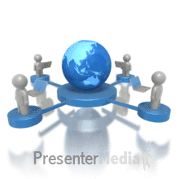
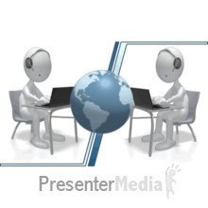
Internet
The Internet is a Global System that
  consists of millions of
    public,
    private,
    academic,
    business and
    government networks.
It is Global Network of Computer
  which may be server or client that exchanges information.

Slide 3
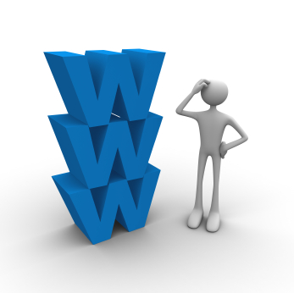
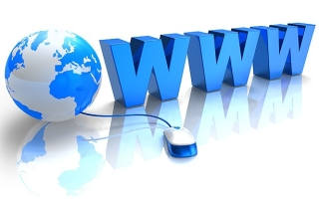
WWW (World Wide Web)
Founder: Time Berners Lee(invented it in CERN)
  Who also invented HTML.
Idea of WWW came up in 1989.
W3C(World Wide Web Consortium) is the standard making body for web and HTML.
The World Wide Web, or just "the Web”, as ordinary people call it, is a subset of the Internet.
The Web consists of pages that can be accessed using a Web browser.
WWW is a service that operates on Internet(just like e-mail).

Slide 4
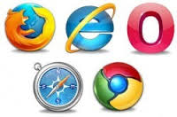
Web Browsers
It is a software for
    retrieving, presenting and traversing information on WWW.
Acts as an interface between user and internet.
A browser is a software typically used to display HTML documents.
First web browser Mosaic made in 1993.
First browser was made by Marc Andersson.
Examples are –
Mozilla Firefox,
IE,
Chrome,
Opera.

Slide 5
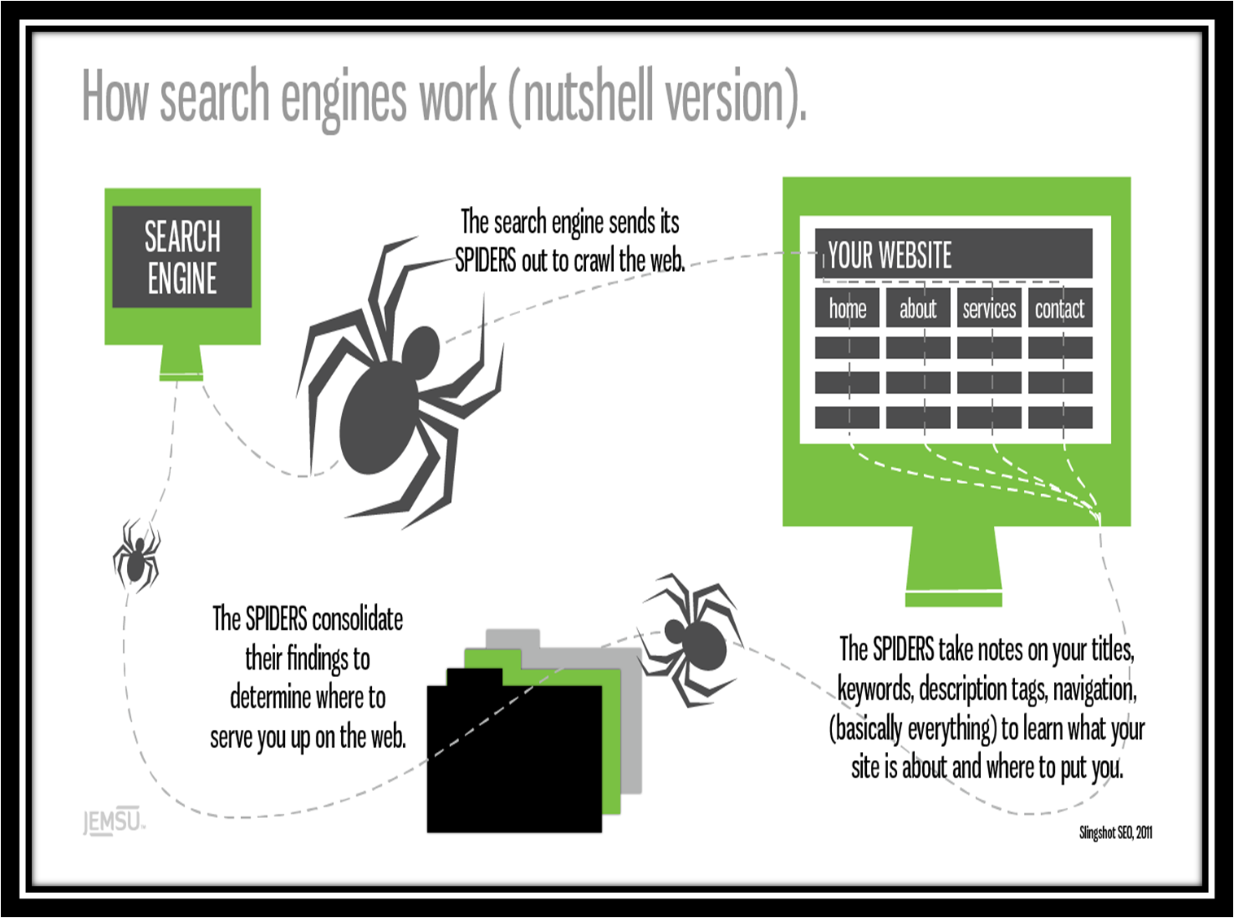
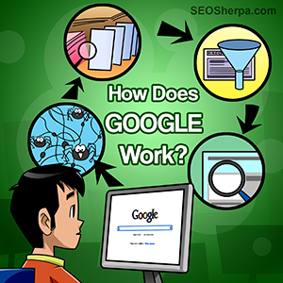


Slide 6
Website/Web Applications
Websites/ web applications are applications that are accessed via web browser.
Runs on a server called Web server.
Can be accessed using a Uniform Resource Locator.
A webpage is a document, typically written in plaint text interspersed with formatting instructions of Hypertext Markup Language.
It can contain text, images, or links etc.
Show example.

Slide 7
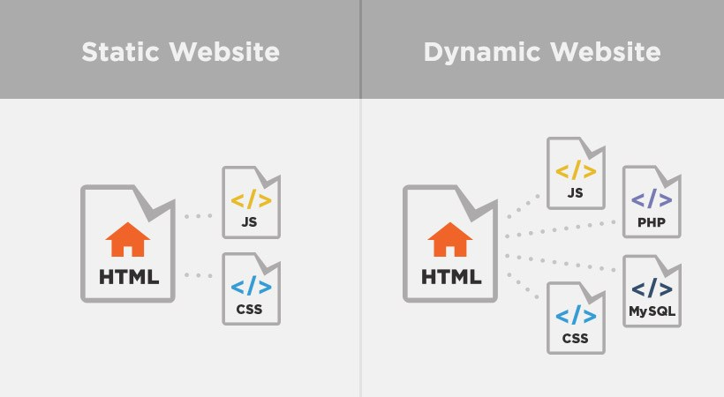
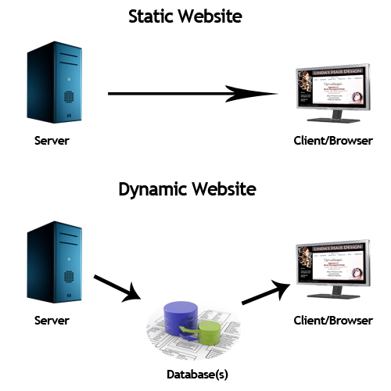
Static vs Dynamic Website

Slide 8
Static Website …
Static websites:
  are those in which the content of the webpages does not change very often.
  No/Very less input from user.
  Loads same content everytime the page is loaded.
  Standard HTML web pages are static.
  The only way to change the content is that the programmer rewrites the contents.
  Eg: http://www.xpec.co.uk/oldsite/

Slide 9
Dynamic Website ..
Dynamic websites:
  Are those in which the content of the webpage changes according to the input of user.
  In these pages the content can change every time the page is loaded.
  This kind of website is made in PHP, Java, .Net and etc.
  The page changes its content according to the input given by the user.
  Eg:- facebook.com, google.com etc.

Slide 10
Web Server
The term Web Server refers to the hardware or the software that helps deliver the web content that can be accessed through the internet.
Web communication takes place between a client process(browser) and a server.
Web servers provide services over web.
If any client wants to access a service over internet, it should send a request to a server and server responds back to the request.
One of the services provided by a web server is HTTP data.
Web servers can also be used to host gaming or enterprise applications.
Eg: Apache, IIS, nginx, GWS etc.

Slide 11
URL
Uniform Resource Locator.
Also known as web address.
Used to identify each web page uniquely.
What we write in the address bar of a browser is called URL.
Starts with http or https.
Eg:- http://www.lpu.in/about_lpu/LPU_at_a_glance.php

Slide 12
HTTP
Hyper Text Transfer Protocol is a protocol responsible for transfer of web data over WWW.
Hypertext is structured text that uses hyperlinks between webpages containing text.
HTTP is the protocol to exchange or transfer hypertext.
HTTP functions as a request-response protocol in the client-server computing model.
Port used by this protocol is 80.

Slide 13
Working of HTTP
The client submits an HTTP request message to the server.
The server, which provides resources such as HTML files and other content, returns a response message to the client.
The response contains completion status information about the request and may also contain requested content in its message body.

Slide 14
HTTPS
HTTP Secure.
Is a communication protocol for secure communication over WWW.
It is not actually a protocol, but is a result of layering HTTP over SSL.
Provides authentication of a website or web server, which protects against Man-in-the-middle attack.
Provides encryption of communication between client and server, which protects against eavesdropping and tampering.

Slide 15
Hosting a Website
To make your Web site visible to the world, it has to be hosted on a Web server.

Slide 16
Local Host
Local host means this computer.
It is a hostname that the computer's software and users may employ to access the computer's own network services.
localhost resolves to the address 127.0.0.1
The local loopback mechanism is useful for programmers to test software during development

Slide 17
Local Server
Local server generally refers to a server running on the system in question.
It can be accessed at 127.0.0.1.
Used for testing purposes.
In real time scenario if one has to test the webpage or website they will have to upload it over a remote server(webserver) to test it, which takes a lot of time.
Local server provides this facility on the current computer only.
One can make a current computer a local server by installing Apache or IIS on their computers.

Slide 18
Advantages of a Web Site
Business is open 24*7.
Increased Customer Base.
Tremendous cost saving- reduced man power and less resources.
Advertising opportunities.
Customer satisfaction.
Showcase your work.

